Slide 1
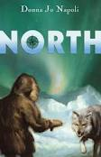
North By Donna Jo Napoil

Slide 2
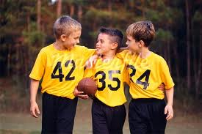
These kid were talking about their research projects.

Slide 3
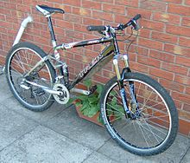
They all rode bikes to the cemetery on the other side of town.

Slide 4
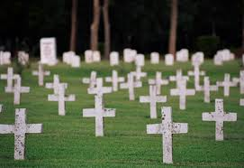
When they got to the cemetery they asked where Matthew Henson’s Grave was.

Slide 5
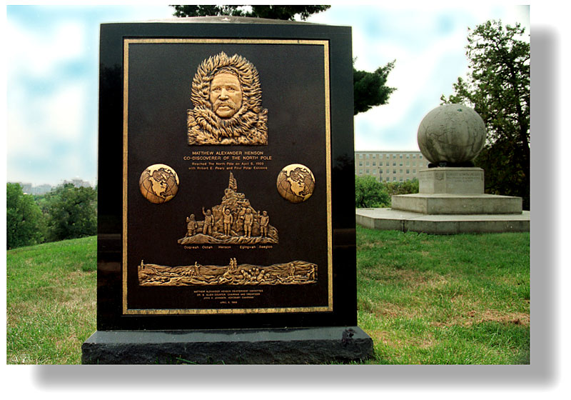
They go and look at his grave stone and it said co Discover of the North Pole.

Slide 6
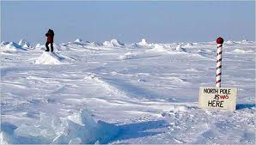
To prove that Matthew Henson discovered the North Pole he went to find the mark that he left.

Slide 7
Sits Used
AP images
Soundzabound

